Slide 1


Financial Dashboard using StreamLit
Arunkkumar Karthikeyan
November 30,2022
Prof.Minh Phan

Slide 2

Audio
Click Here

Slide 3


Overview
To construct a Financial Dashboard using streamlit by fetching financial stock information from Yahoo Finance service
To predict the future activity of the selected ticker
The dashboard is dynamic and interactive for the traders who can make buying and selling decisions
Stock Summary
Chart
Financials
Stock Statistics
Stock Company Profile and Description
Monte Carlo Simulation
Stock Analysis
Sustainability
Stock Recommendations
Challenges
Links

Slide 4
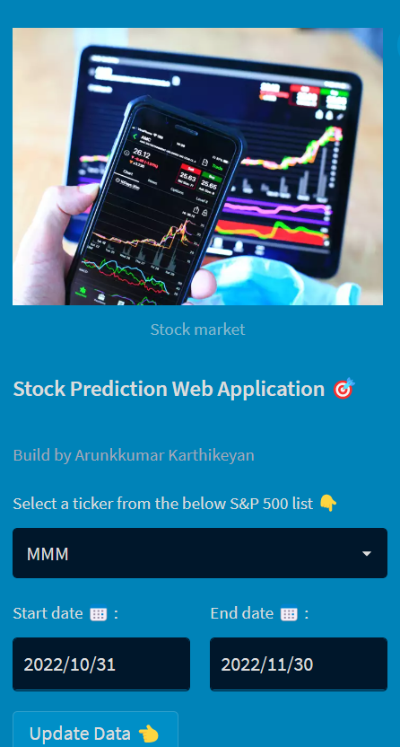
Streamlit Sidebar
Streamlit sidebar is used for
selecting the ticker from list of S&P 500
Selecting the start date and end date period for the selected ticker
An update button to update / refresh the ticker data

Slide 5
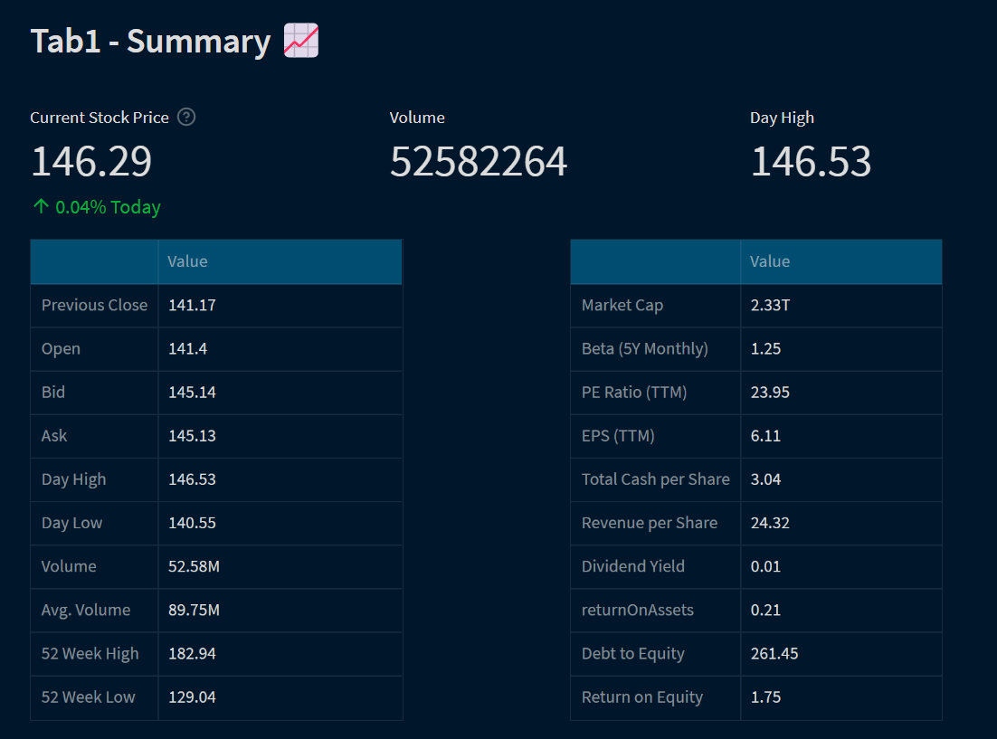


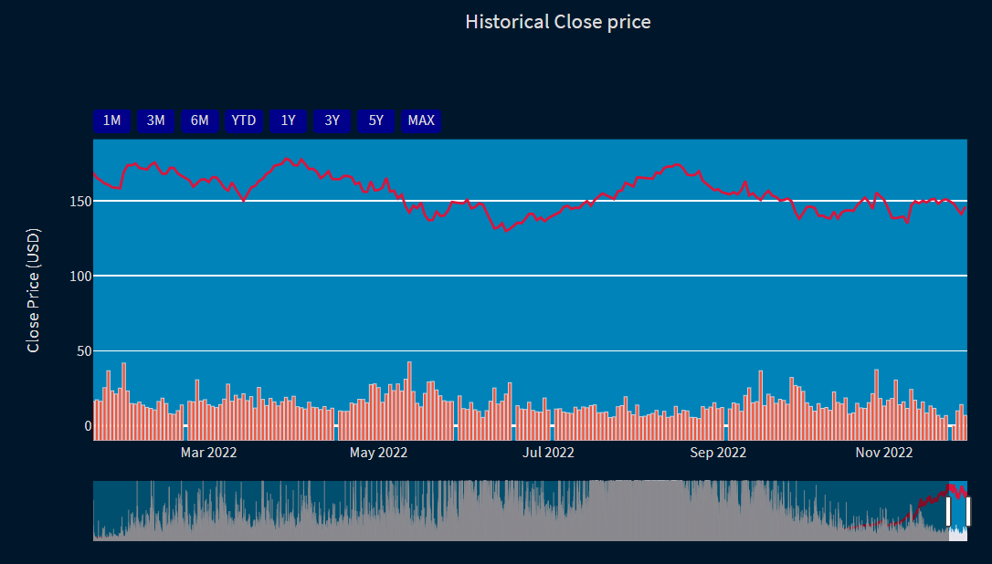
Stock Summary
To view the important statistics of the selected ticker
To view the trend of close price for the selected time period
Function to get the Stock Summary : yf.Ticker(ticker).info
Apple Stock Summary Example
Tab 01

Slide 6
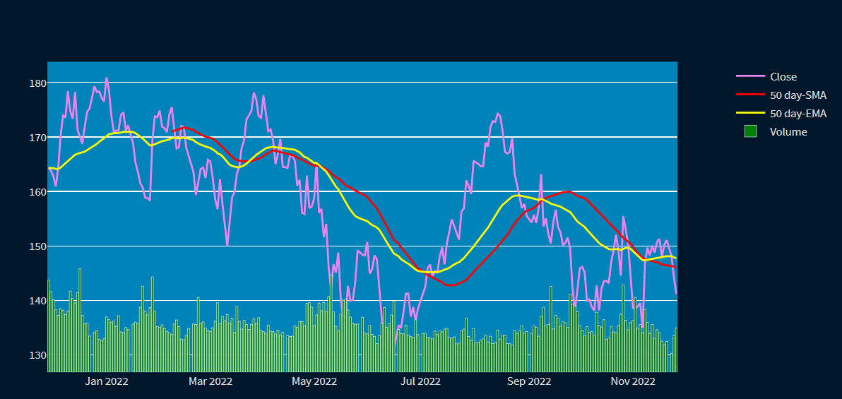
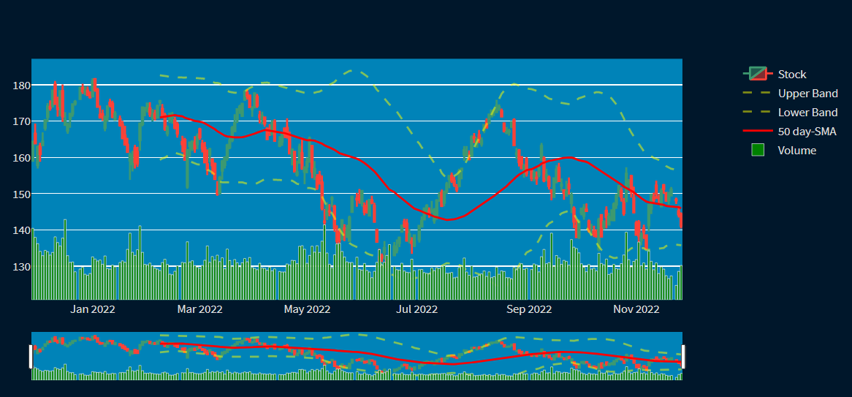
Chart
Visualization of stock trend over the period
To view different type of plots
Moving Average, Bollinger Bands indicators are included
Function to get the Stock historical data : yf.Ticker(ticker).history(start, end)
Apple Chart Example
Tab 02

Slide 7
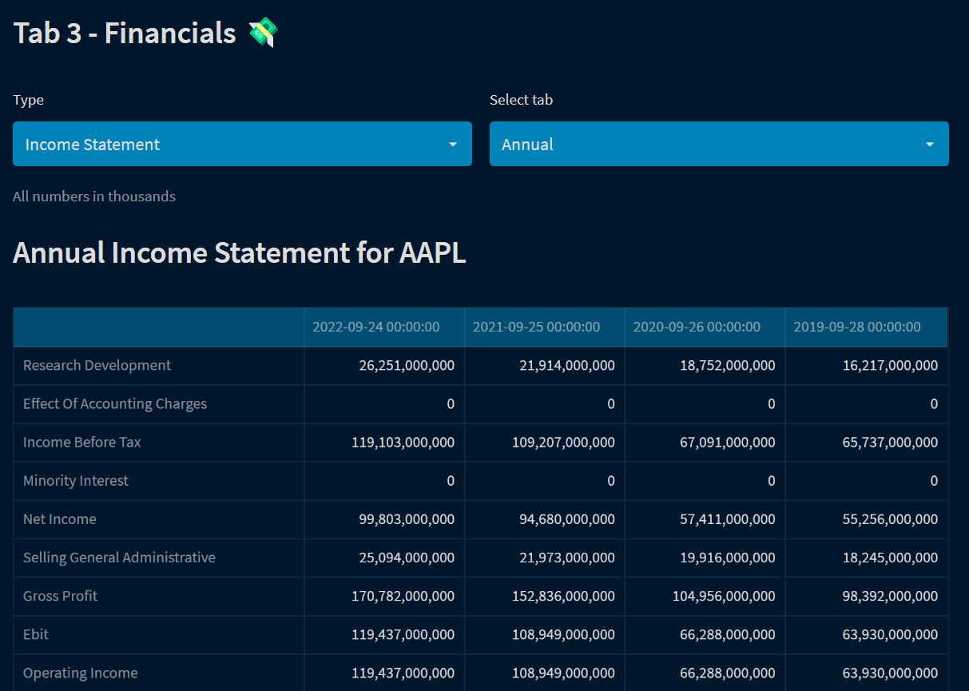


Financials
To view all financial statements such as Balance Sheet, Cash Flow and Income statement for selected ticker for annual and quarterly time period
Function to get the Stock financial
information : yf.Ticker(ticker).history(start, end)
Tab 03

Slide 8
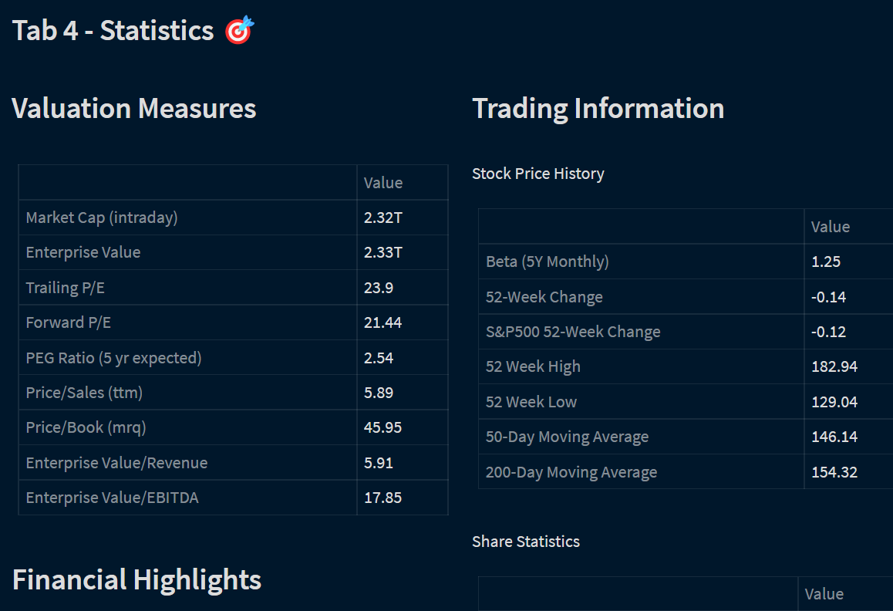

Stock Statistics
To view complete list of stock statistics such as Profitability, Dividends & Splits etc.
Function to get the Stock statistics
: yf.Ticker(ticker).info
Tab 04

Slide 9
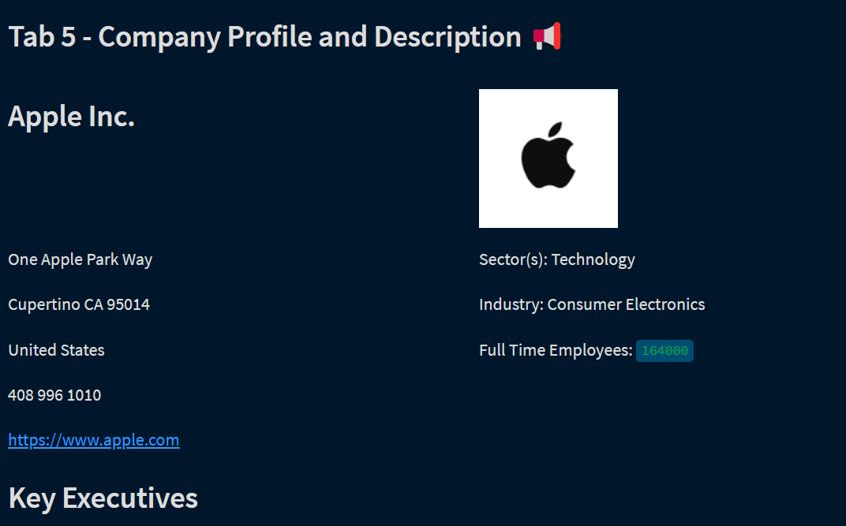
Stock Company Profile and Description
To view about stock company profile and description
Function to get the company profile information : yf.Ticker(ticker).info &
si.get_company_officers
Tab 05

Slide 10
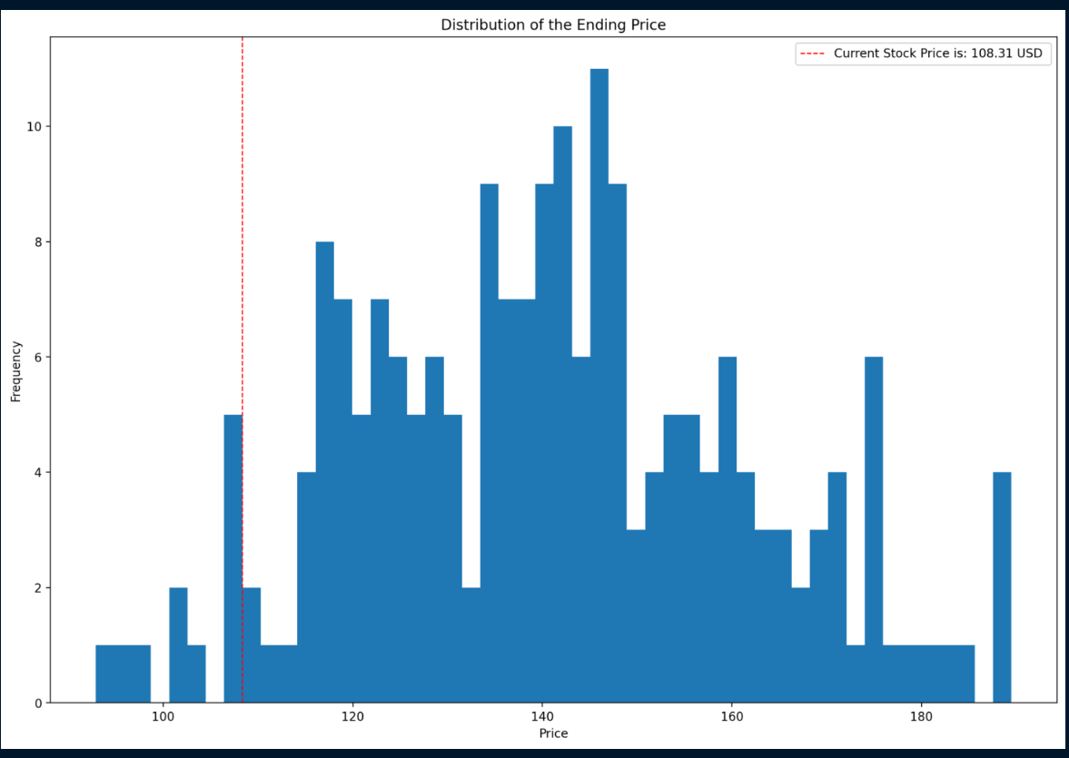
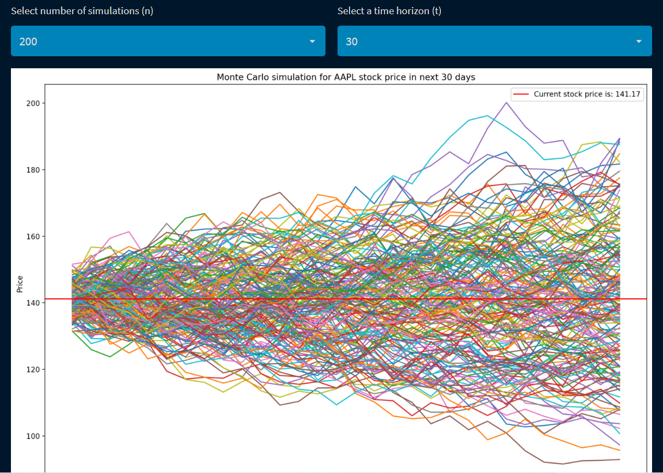
Monte Carlo Simulation
To view stock price prediction
Select between time horizon and number of intervals
Value at risk calculated for the selected ticker
Function used to get Monte Carlo simulation: yf.Ticker(ticker).history(start, end)
Tab 06

Slide 11
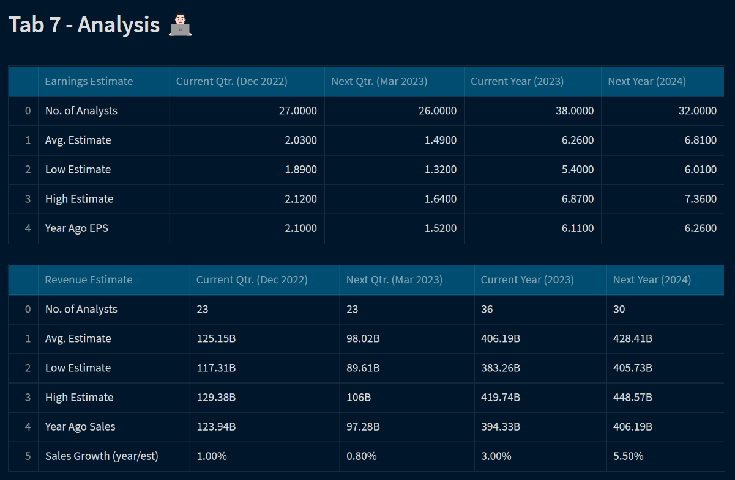
Analysis
To view future estimates like Earnings and Revenue estimates for the next few quarters.
Function si.get_analysts_info(ticker) is used to fetch the analysis of stocks
Tab 07

Slide 12
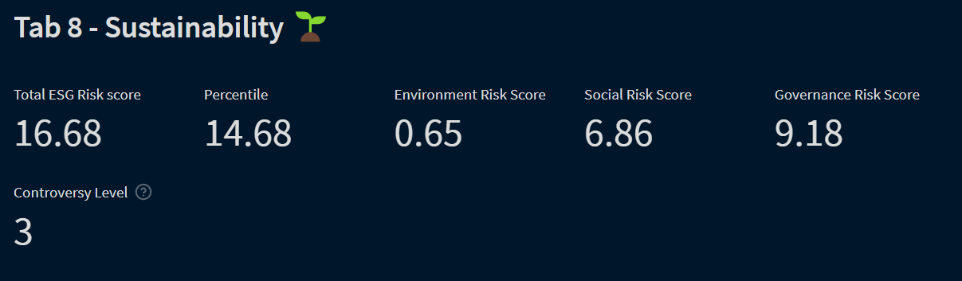
Sustainability
To view data such as environmental risk score, social risk score of the selected ticker
Function yf.Ticker(ticker).sustainability is used to fetch the sustainability data
Tab 08

Slide 13
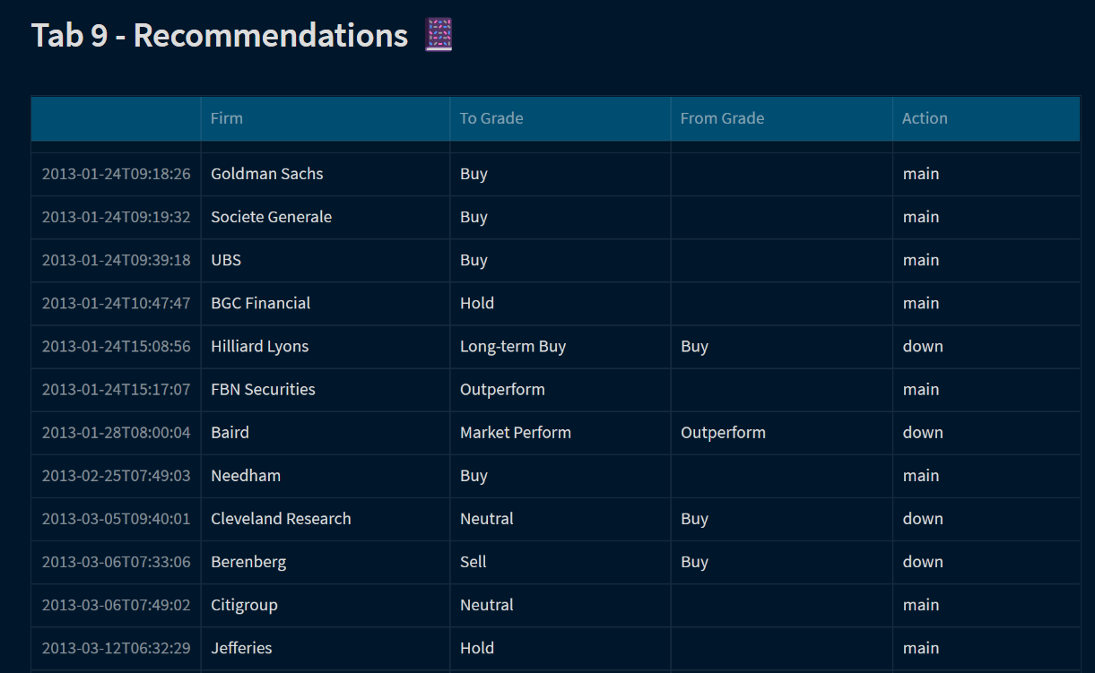
Reccomendations
To view recommendations of firm on the selected ticker to buy/ sell / outperform
Function yf.Ticker(ticker).recommendations is used to fetch the data
Tab 09

Slide 14
Challenges
It is important to understand and develop the logical structure within each function definition
The sequential order and indentation of codes are very important in Python
Learning the various functions of streamlit such as st.columns, st.tabs, st.write, st.metric, st.dataframe, st.table etc.
Learning how to interpret codes written in Python with Streamlit
Learning the different options of Plotly graphs for visualizations

Slide 15


Links
GitHub Link :
https://github.com/Arunkkumarkarthikeyan12/Financial-Dashboard-using-Streamlit
Streamlit Cloud Link:
https://arunkkumarkarthikeyan12-financial-das-financialdashboard-84ccmg.streamlit.app/

Slide 16

References
Subplots in Plotly- https://stackoverflow.com/questions/67291178/how-to-create-subplots-using-plotly-express
Bollinger Bands- https://albertum.medium.com/plotting-bollinger-bands-with-plotly-graph-objects-1c7172899542
Emoji - https://emojipedia.org/chart-increasing/
Simple Moving Avg & Exponential Moving Avg - https://www.learnpythonwithrune.org/simple-and-exponential-moving-average-with-python-and-pandas/
Unified x and y axis - https://community.plotly.com/t/any-way-to-have-both-x-unified-and-y-unified-for-hovermode-like-crosshair/63340/2
Monte Carlo Simulation – Class Note Sessions
Streamlit Related - Official Streamlit docs/ Community threads - https://docs.streamlit.io/library/api-reference

